Slide 1
RX13T Series MCU
NPI Overview
March, 2020

Slide 2
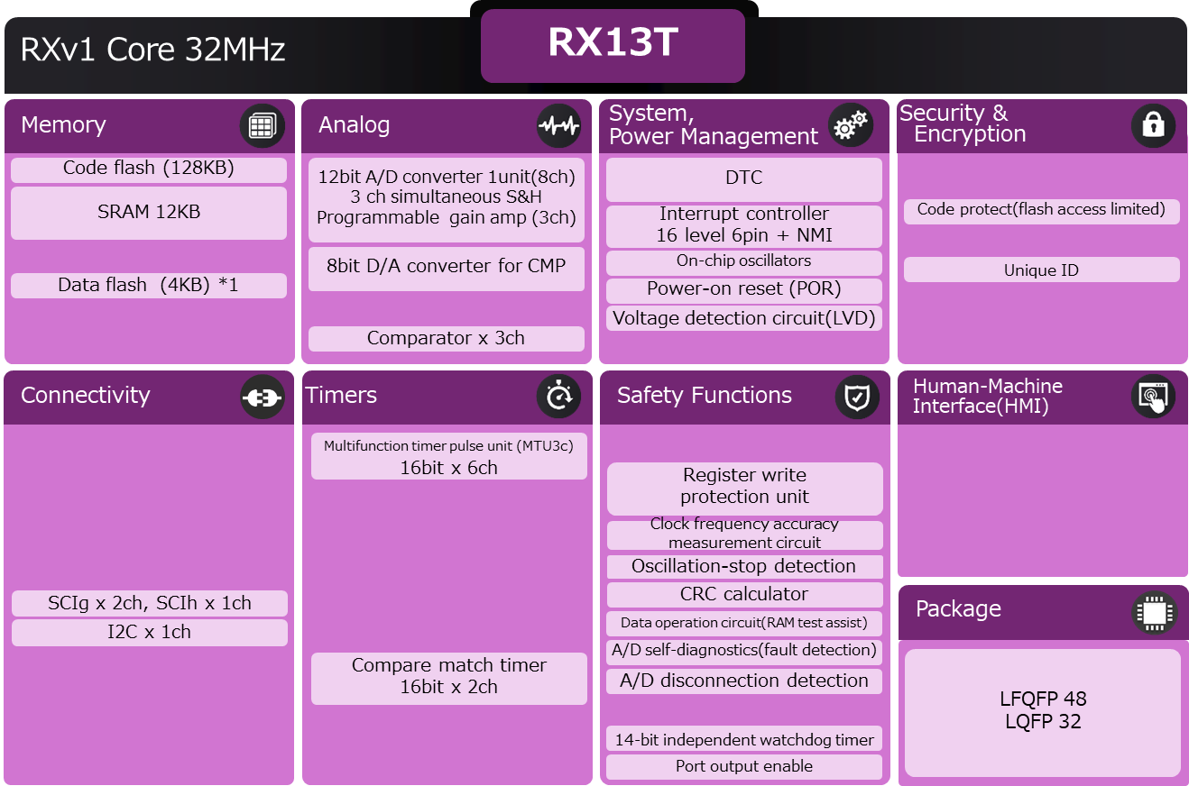
RX13T Product Snapshot
Optimized Single Motor Control RX MCU series
Features
Benefits
Applications
RX microcontrollers with RXv1 core
  Enhanced analog function
  Single precision FPU
128 KB FLASH, 12 KB RAM,
4 KB Dataflash
12-bit ADC (1 unit) with 3 simultaneous S/H
Built-in analog omparators (3 ch)
Build-in programmable gain amp (PGA 3 ch)
Safety functions
Supports 2.7V ~ 5.5V operation
Low pin count (32 or 48 pins)
Compact code size
BOM cost reduction with built-in enhanced analog function
Safety functionality embedded
Support 2.7V ~ 5.5V operation
Industrial grade 105°C operating temperature part available
Single Motor Control Application
  Fan control
  Pumps
  Refrigerators
  Vacuum cleaners
  Printers
  Small robots
  Etc.
Block Diagram & Development Tools
RX13T
Block Diagram
Development Tools
Items |  | Status
IDE | CS+ | Support
 | e2studio
 | EWRX(IAR)
Smart configurator
FIT
Flash tool | RFP
 | PG-FP6
Emulator | E1
 | E2
 | E2 lite
CPU card
Notes:
2

Slide 3
Renesas.com

